Slide 1


WEB HOSTING USING AWS EC2 INSTANCE
(A CLOUD BASED WEB HOSTING SYSTEM)
Presented by
Group 3
Under guidance of

Slide 2
OUR MEMBERS
SL NO | NAME
1 | DEBASISH BISWAS
2 | TRIRANJAN SAMANTA
3 | SUBHAJIT PRAMANIK
4 | MD REHAN NASAR
5 | DEBOSMITA MONDAL
6 | SUHANA PERVIN
7 | TRISHA MUKHERJEE
8 | SNEHA SAHA
9 | SANTANU SHAW
10 | RIYA DEY
11 | ESHITA ROY
12 | AKASH KUMAR GUPTA

Slide 3
CONTENTS
SL NO | TOPICS | PAGE
1 | PROJECT OBJECTIVE
2 | WHY CLOUD COMPUTING
3 | AWS ON CONTEXT OF CLOUD COMPUTING
4 | WHY AWS OVER OTHER CLOUD PROVIDERS
5 | AWS PRICING
6 | PROJECT OVERVIEW
7 | USED TECHNOLOGIES
8 | EC 2
9 | ELESTIC IP
10 | ELB
11 | AWS ASGs
12 | PROJECT GALARY
13 | CONCLUSION

Slide 4
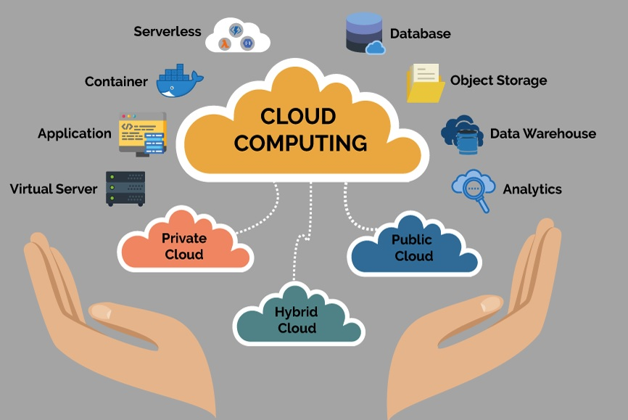
PROJECT OBJECTIVE
The objective of the project is to host a static website (made of HTML , CSS and Javascript ) using AWS services.
This application is developed to make our website globally accessible to everyone , handle requests properly with Elastic Load Balancer and autoscaling , Maintain a stable IP address for our application with elastic IP and many more ..

Slide 5
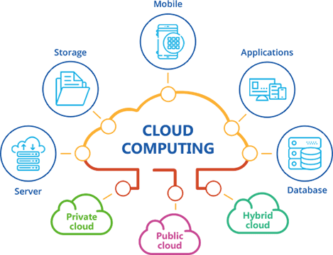
WHY CLOUD COMPUTING ?
Cloud computing is important for several reasons, and it has had a profound impact on the way businesses and individuals use technology. Here are some key reasons why cloud computing is important
Cost-Efficiency
Scalability
Accessibility
Flexibility
Security
Collaboration
Innovation
Environmental Benefits
Cost Predictability
Global Reach

Slide 6
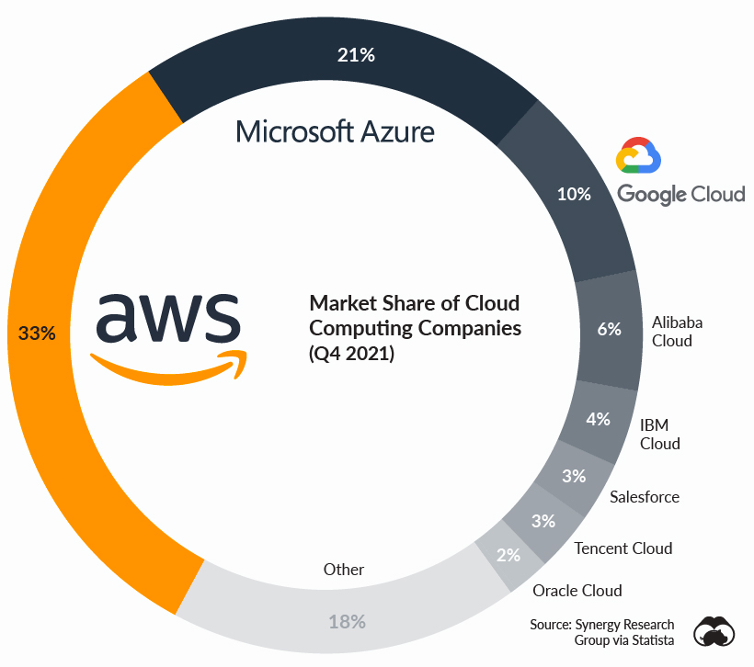
AWS on context of Cloud Computing
Amazon Web Services (AWS) is one of the world's leading and most widely used cloud computing platforms. It provides a comprehensive suite of cloud services that businesses, organizations, and individuals can use to host applications, store data, and manage various IT resources in a scalable and cost-effective manner. When discussing AWS in the context of cloud computing, it's important to understand its key features and services:
Infrastructure as a Service (IaaS)
Platform as a Service (PaaS)
Software as a Service (SaaS)
Storage Services
Databases
Content Delivery
AI and Machine Learning
Analytics
Internet of Things (IoT)
Security
Networking
Developer Tools
Management and Monitoring
33 %

Slide 7
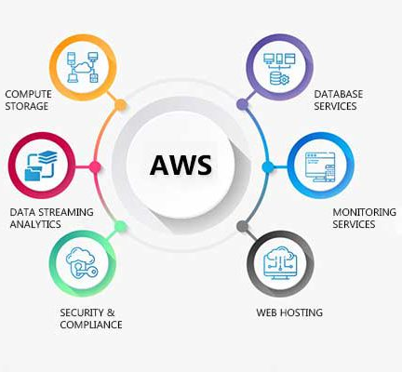
WHY AWS OVER OTHER CLOUD PROVIDERS?
Amazon Web Services (AWS) is one of the major cloud service providers and offers several advantages that make it a preferred choice for many organizations. While the choice of cloud provider should be based on specific business needs and requirements, here are some advantages of using AWS services over other cloud providers
Wide Range of Services
Global Presence
Reliability and Availability
Security
Ecosystem and Community
Scalability
Cost Management
Innovation
Hybrid and Multi-Cloud Capabilities
Migration Services
Enterprise-Focused Services
Data Management

Slide 8
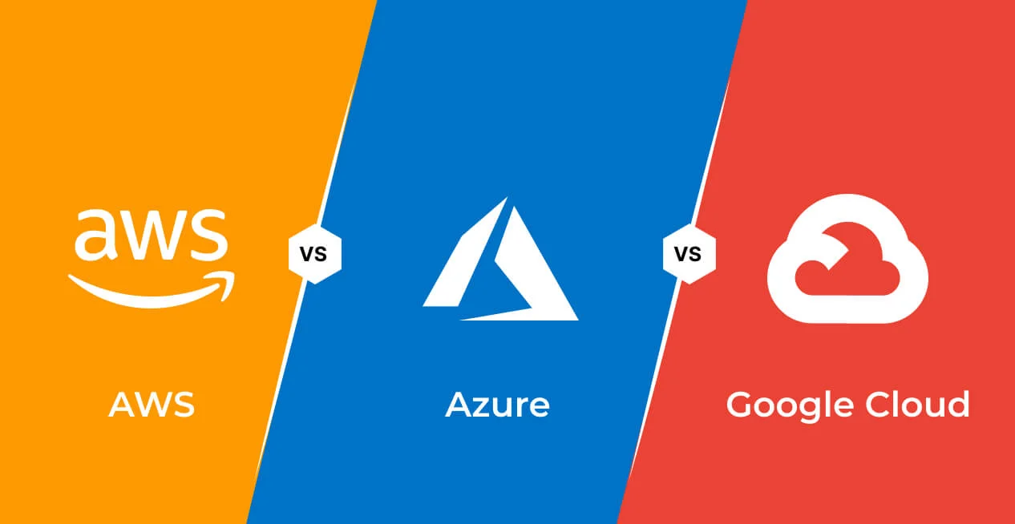
AWS PRICING
Amazon Web Services (AWS) offers several pricing advantages that make it an attractive choice for businesses and organizations:
1. Pay-as-You-Go Model
2. On-Demand Pricing:
3.Reserved Instances (Ris)
4.Spot Instances
5. Elastic Load Balancing:
6.Resource Scaling:
7.Free Tier
8.Cost Explorer and Budgets
9.Consolidated Billing
10.Optimization Recommendations
11.Variable Instance Types
12.Data Transfer Pricing

Slide 9


PROJECT OVERVIEW
In our project, we achieved the following:
Created a stactic website (Zomato_clone) using HTML , CSS and JavaScript
Hosted a website using Amazon EC2 instances.
Implemented load balancing for even traffic distribution.
Set up auto scaling to adapt to changing workloads.
Used Elastic IP addresses for stable, public access to the website.
This architecture ensured high availability, scalability, and reliability for our hosted website.

Slide 10




USED TECHNOLOGIES

Slide 11
Amazon Elastic Compute Cloud (EC2) is a foundational service within Amazon Web Services (AWS), offering scalable and flexible virtual machine instances. In a nutshell, here’s details about AWS EC2 -
Scalable Virtual Machines: AWS EC2 allows users to launch and manage virtual servers (EC2 instances) in the cloud. These instances can be rapidly scaled up or down to accommodate varying workloads, providing cost efficiency and flexibility.
Diverse Instance Types: EC2 offers a wide range of instance types optimized for different use cases, including compute-optimized, memory-optimized, and GPU-powered instances, enabling users to choose the best fit for their specific workloads.
Customizable Configuration: Users can customize instances by selecting the operating system, instance type, storage, and network configurations. This flexibility allows for tailoring resources to meet application requirements.
Security and Management: EC2 instances come with various security features, including Virtual Private Cloud (VPC) for network isolation, security groups, and key pair authentication. These features make EC2 a fundamental service for hosting applications, websites, and a variety of workloads in a scalable and customizable manner within the AWS cloud environment.

Slide 12
Amazon Elastic IP (EIP) is a service provided by AWS that allows users to allocate a static, public-facing IP address for their resources within the cloud. In summary, here are key points about AWS Elastic IP for four marks:
1. Static Public IP: AWS Elastic IP provides a fixed, public IP address that can be associated with AWS instances. It remains constant, even when instances are stopped or terminated, making it ideal for scenarios where IP address stability is crucial.
2. Use Cases: Elastic IPs are commonly used for hosting websites, applications, and services that require a consistent public IP address. They are valuable for enabling external access to resources like EC2 instances or load balancers.
3. Portability: Elastic IPs can be easily associated and disassociated from different AWS resources, offering portability and flexibility in managing public-facing services across instances and availability zones.
4. Cost Implications: While Elastic IPs are free to use as long as they are associated with a running EC2 instance, keeping an unused Elastic IP address allocated to your AWS account when not associated with an instance may incur additional charges. It's essential to release unneeded Elastic IPs to avoid unnecessary costs.

Slide 13
Amazon Elastic Load Balancing (ELB) is a managed service in Amazon Web Services (AWS) that helps distribute incoming network traffic across multiple Amazon Elastic Compute Cloud (EC2) instances or containers for increased availability, fault tolerance, and improved performance. Here's a concise overview of AWS Elastic Load Balancer for four marks:
1. High Availability: AWS Elastic Load Balancer enhances the availability of applications by distributing incoming traffic across multiple EC2 instances or containers, ensuring that if one instance fails, traffic is automatically redirected to healthy instances, minimizing downtime.
2. Load Balancing Algorithms: ELB uses load balancing algorithms like round-robin and least connections to efficiently distribute traffic, optimizing resource utilization and delivering a seamless user experience.
3. Auto Scaling Integration: It integrates seamlessly with AWS Auto Scaling, allowing the automatic addition or removal of instances based on traffic patterns, helping to handle varying workloads without manual intervention.
4. Security and SSL: ELB provides SSL termination, enabling secure communication between clients and the load balancer. It also supports security features like AWS Web Application Firewall (WAF) and integrates with Virtual Private Cloud (VPC) for network isolation, enhancing security for applications.

Slide 14
Amazon Elastic Auto Scaling is a crucial AWS service that allows you to automatically adjust the number of resources in your application to match demand. In summary for four marks:
1. Dynamic Resource Scaling : AWS Elastic Auto Scaling enables you to automatically increase or decrease the number of EC2 instances based on predefined conditions or metrics, ensuring optimal resource allocation to handle varying workloads.
2. High Availability : It enhances the availability and fault tolerance of your applications by distributing traffic across multiple EC2 instances, reducing the risk of overloads or outages.
3. Efficient Cost Management : With auto scaling, you only pay for the resources you need, as instances are added or removed based on demand. This cost-effective approach helps eliminate unnecessary infrastructure costs.
4. Easy Configuration : AWS Elastic Auto Scaling provides simple configuration options through auto scaling groups and launch configurations, making it easy to set up and manage, while also integrating with other AWS services for enhanced flexibility and control.

Slide 15




PROJECT GALARY

Slide 16




Slide 17

This project has been appreciated by all the users in the organization. It is easy to use, since it uses the AWS provided in the user dialog. User friendly screens are provided. The usage of software increases the efficiency, decreases the effort. It has been thoroughly tested and implemented. In India, the real estate sector is the second-highest employment generator, after the agriculture sector. The growth of this sector is well complemented by the growth in the corporate environment and the demand for office space as well as urban and semi-urban accommodation. Hence the correct prediction of rise and fall of prices in this sector becomes important.

Slide 18


